Slide 1

NASACRE conference 2026
Menti-meter activity

Slide 2
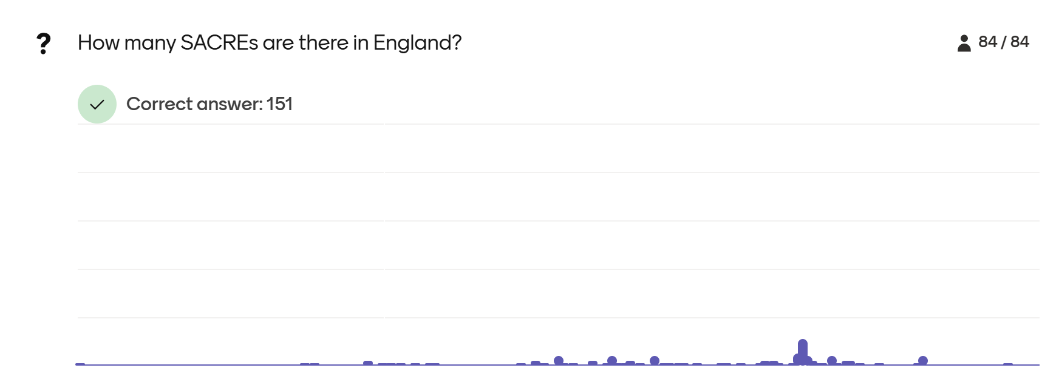

Slide 3
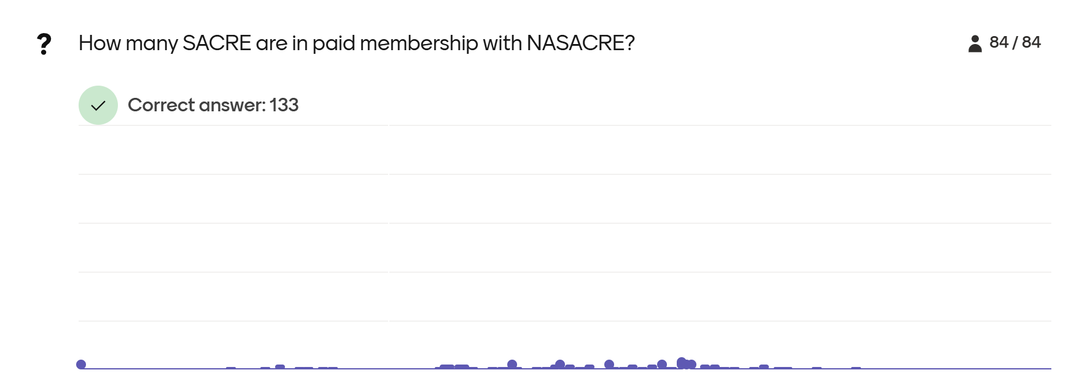

Slide 4
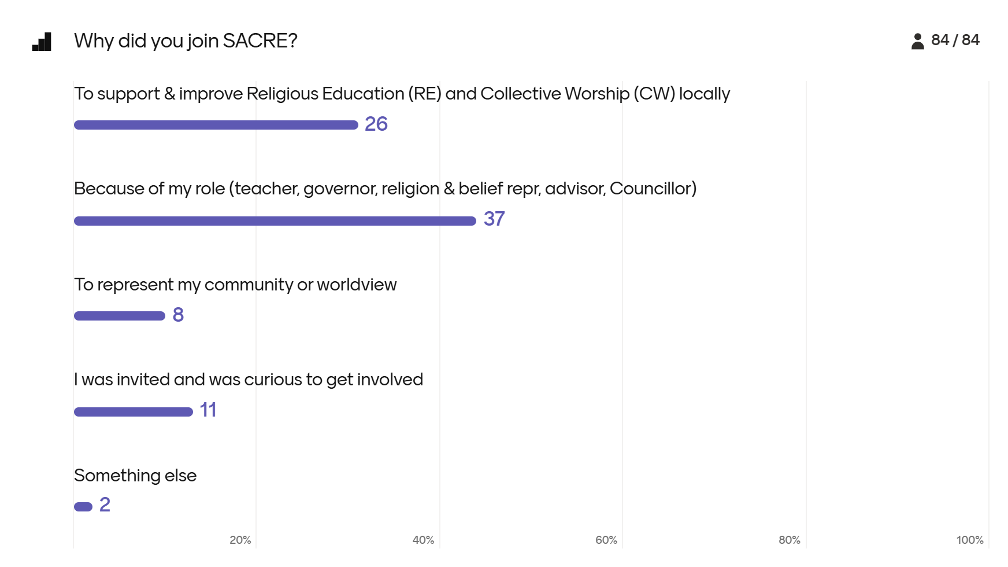

Slide 5
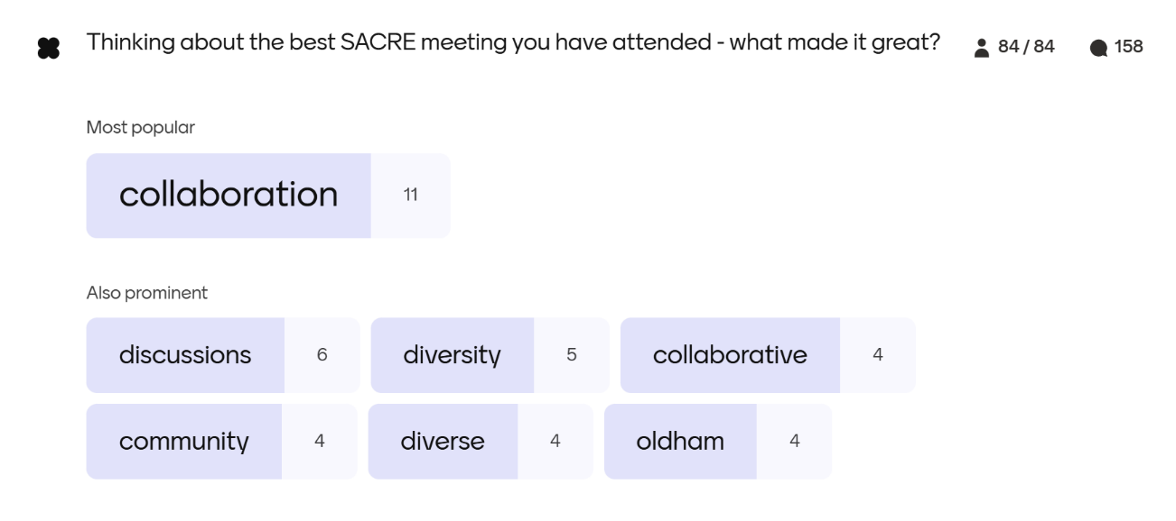

Slide 6

Other answers were:

Slide 7
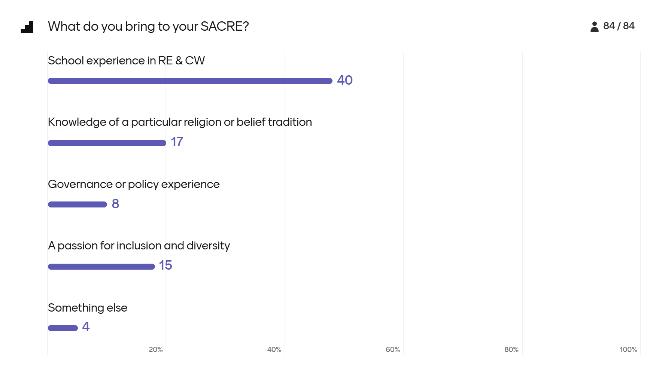

Slide 8


Slide 9

Other answers were:

Slide 10
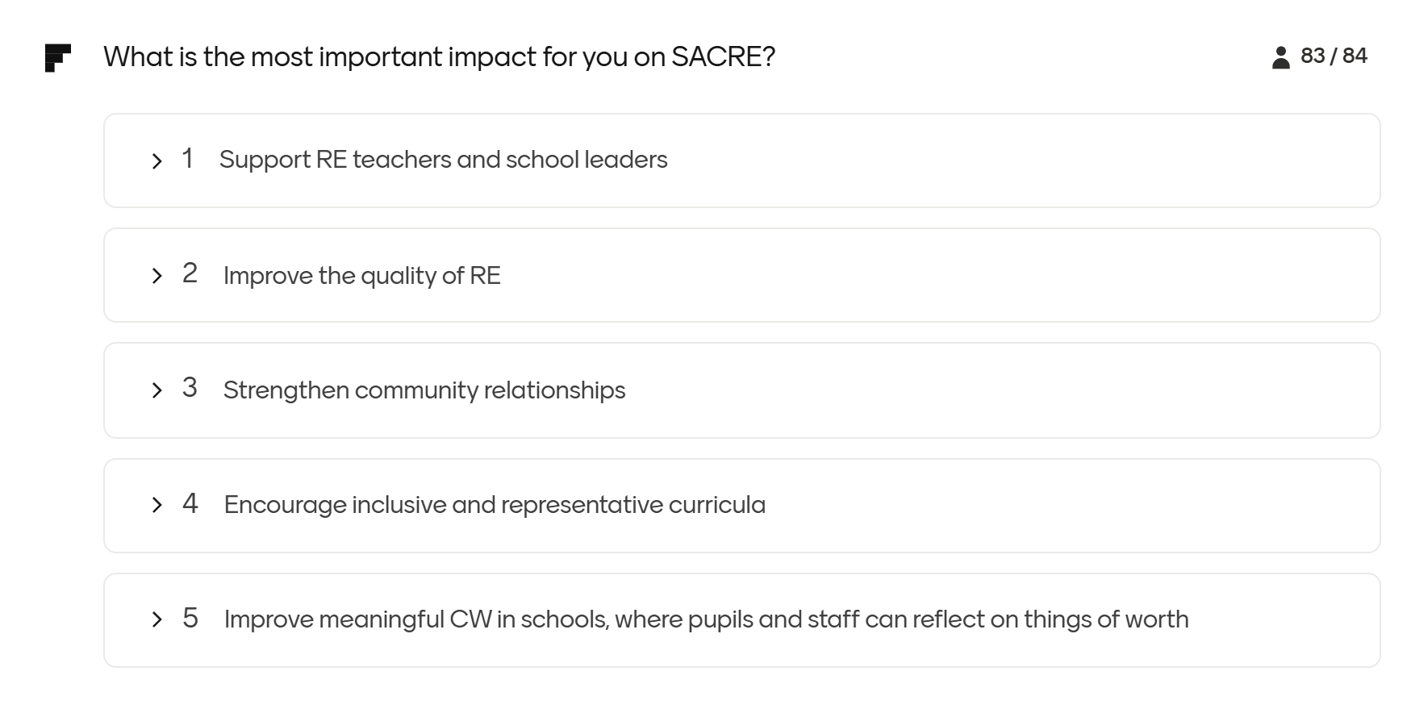

Slide 11


Slide 12

Other answers were:

Slide 13
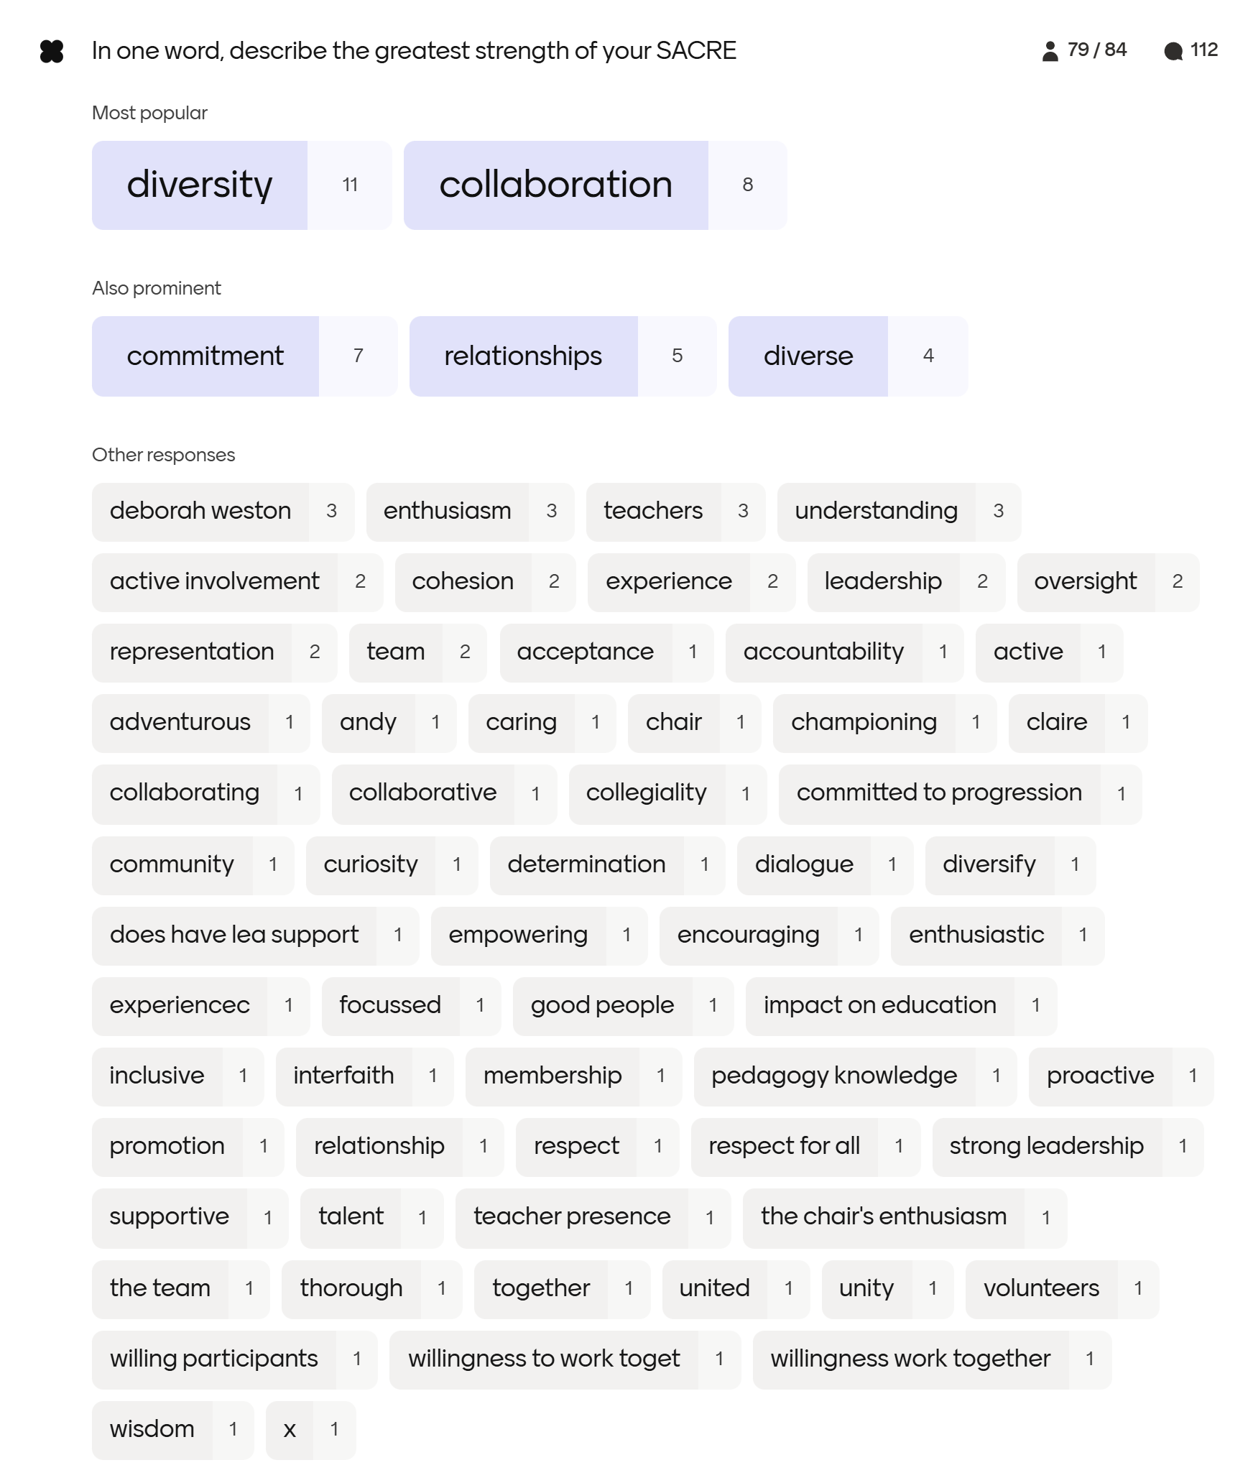

Slide 14
Other answers were:

Slide 15
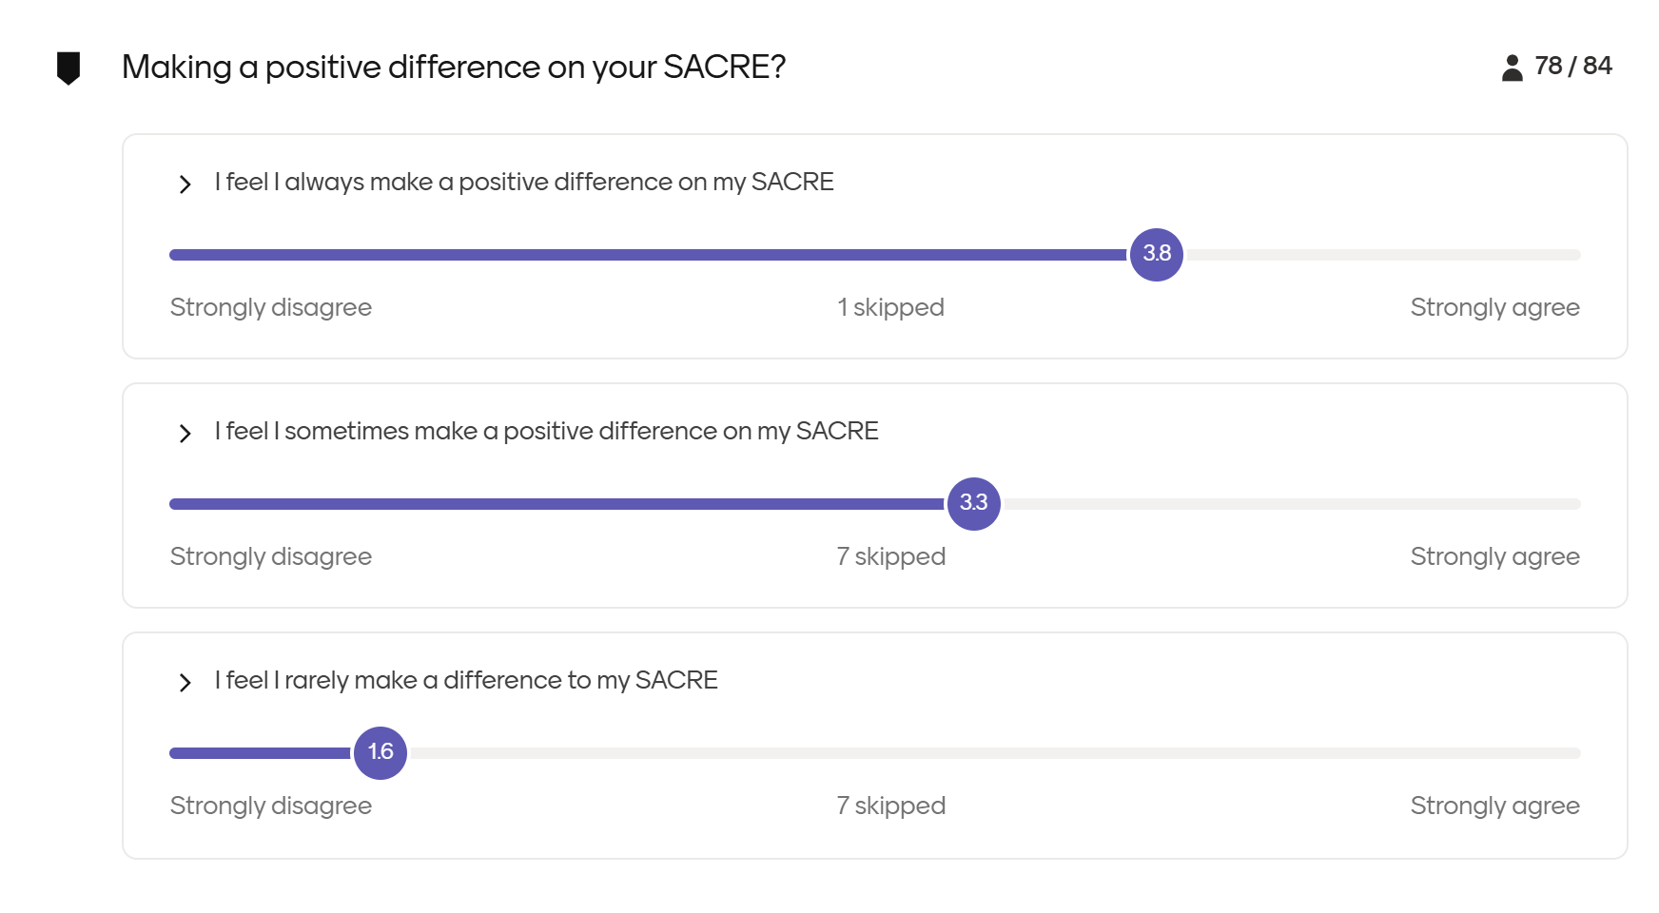

Slide 16
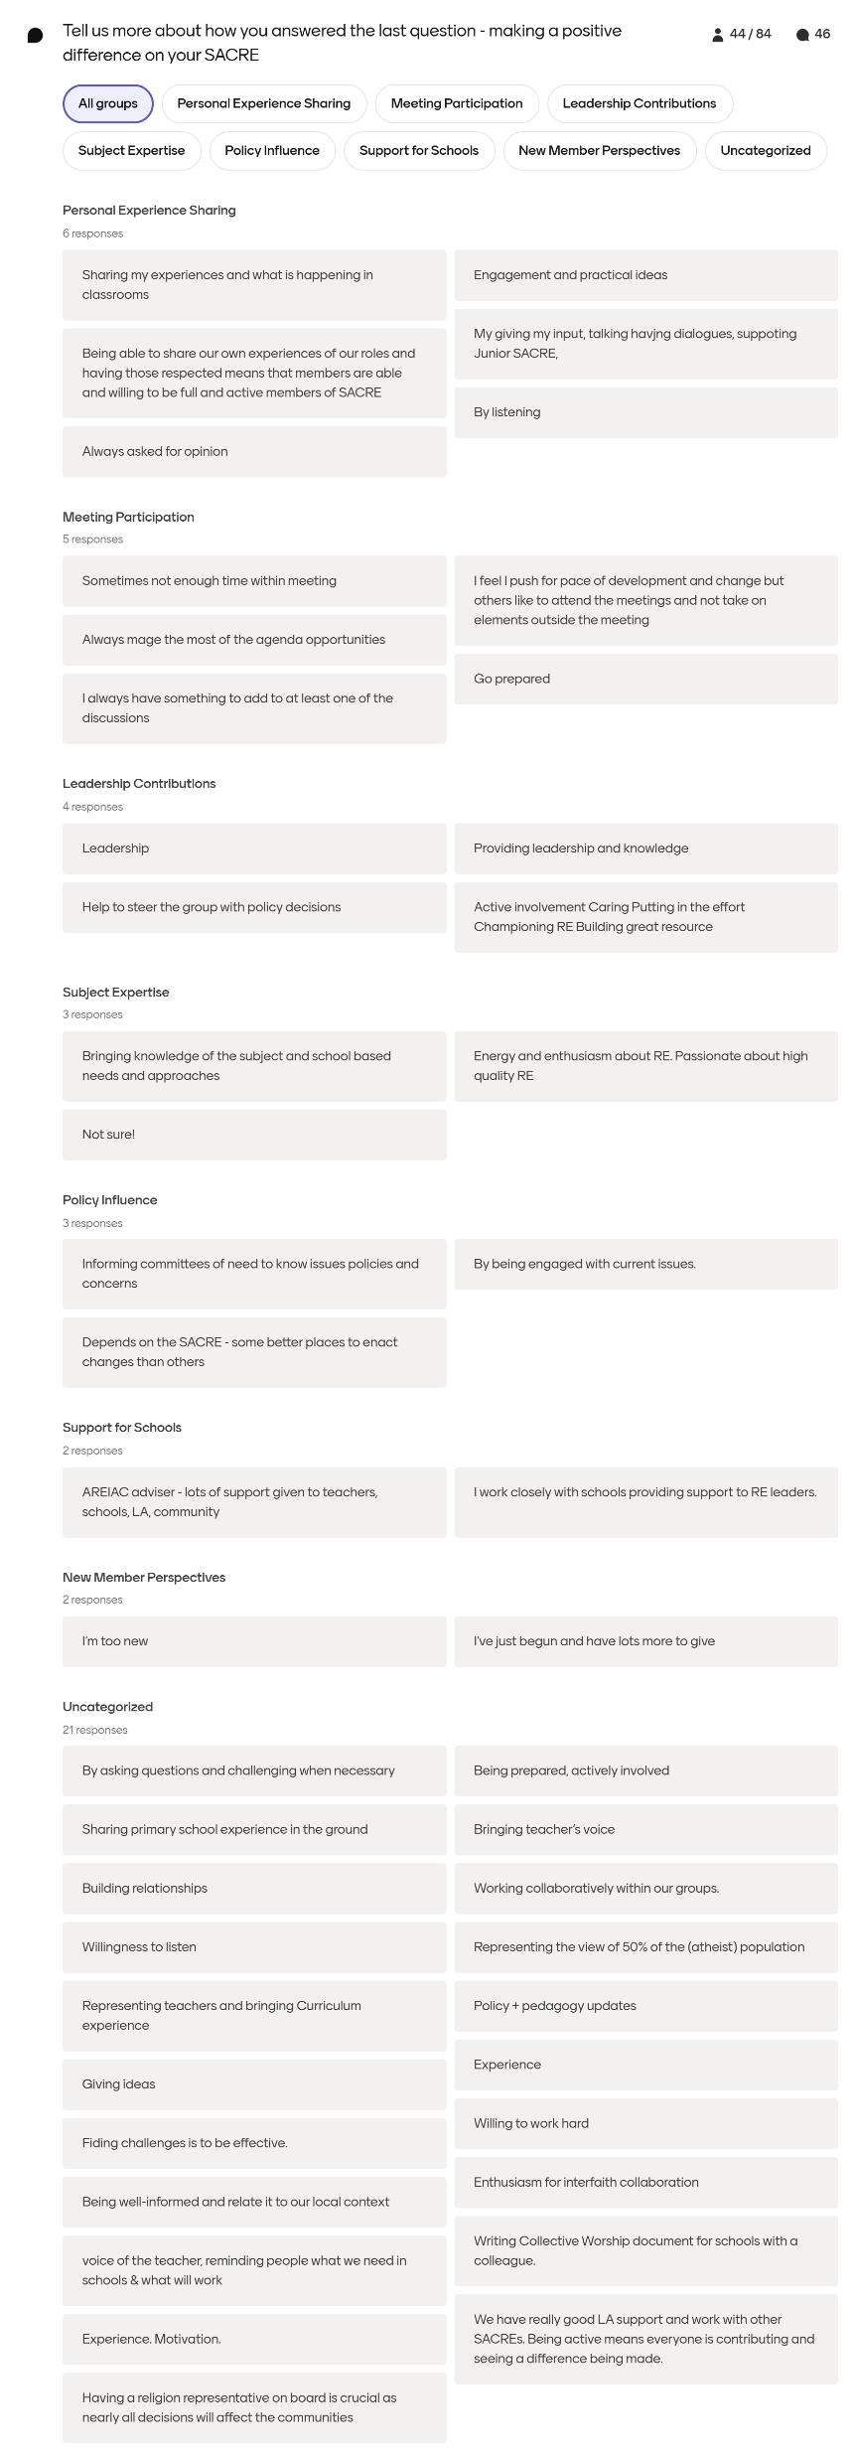

Slide 17
Other answers were:

